Slide 1
California water fix
South Delta Water Agency Parties
Case-In-Chief Part 2
SDWA 292
TESTIMONY OF TOM BURKE

Slide 2
Analysis
Evaluated the Impact of the CWF on the Water Quality Effecting Wildlife in The Central and South Delta
  Change in Salt Loading To The South Delta
  Inflow / Outflow Locations
  PA compared to the NAA

Slide 3
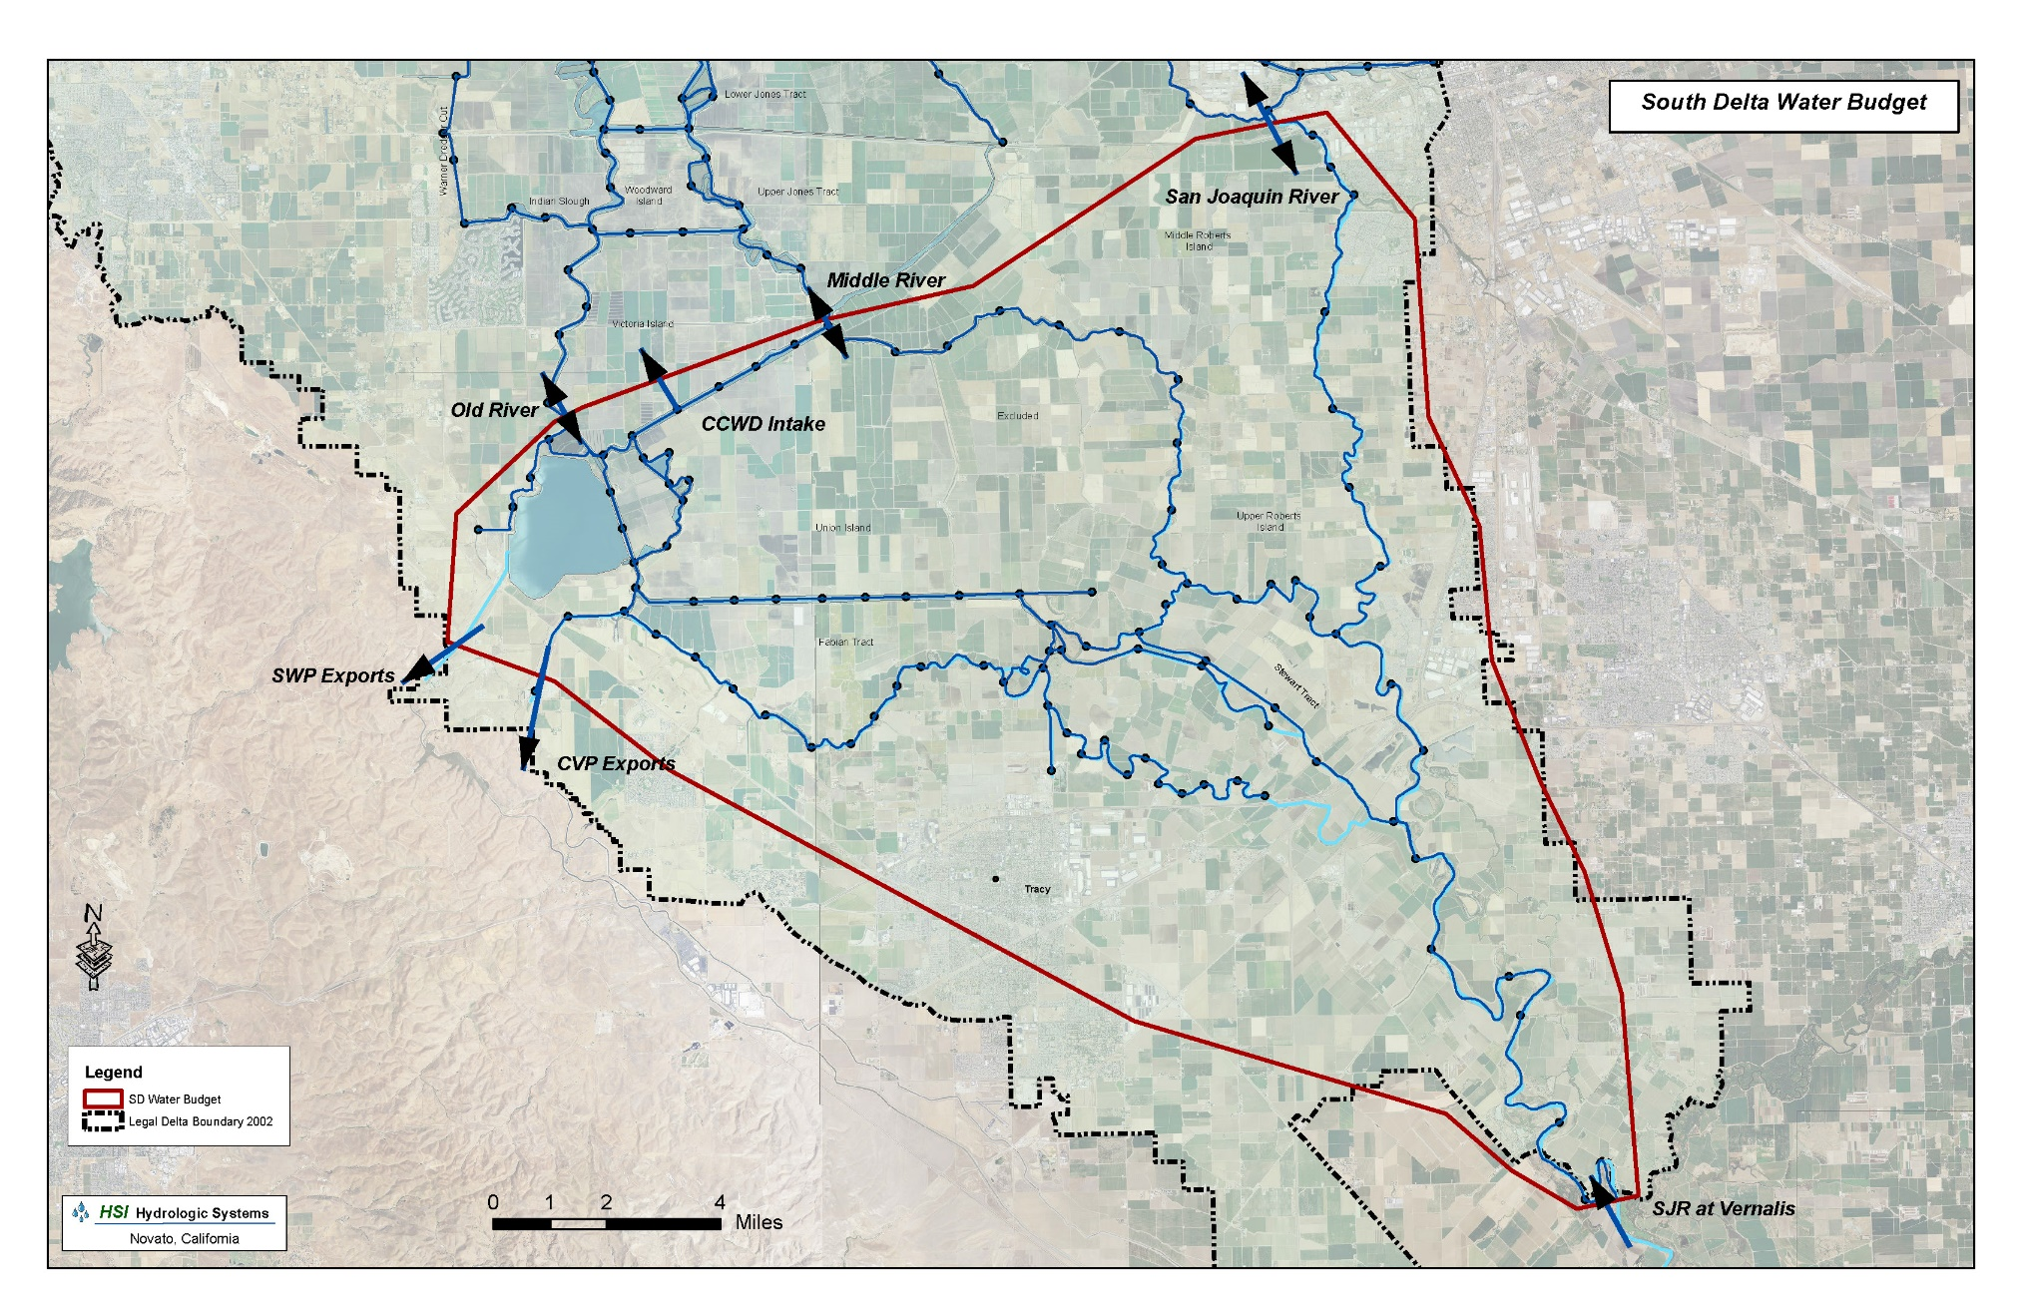

Slide 4
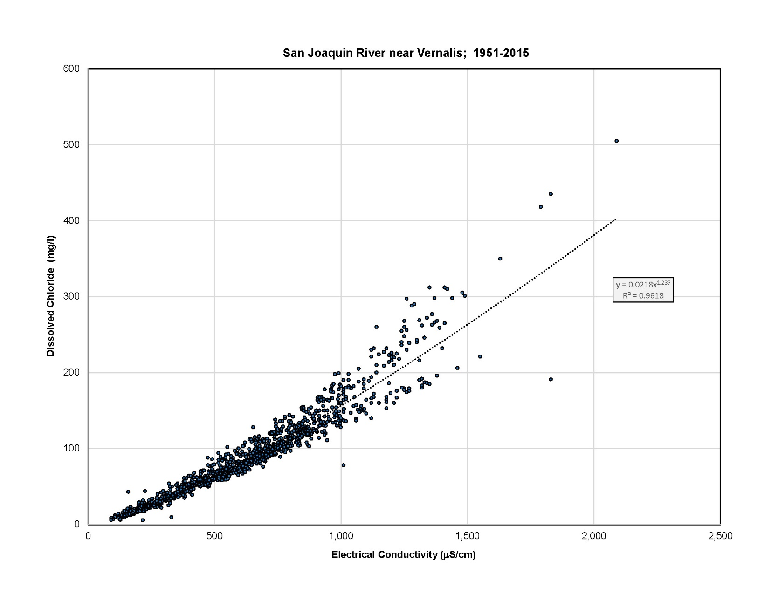
Sacramento River near Vernalis Cl vs EC

Slide 5
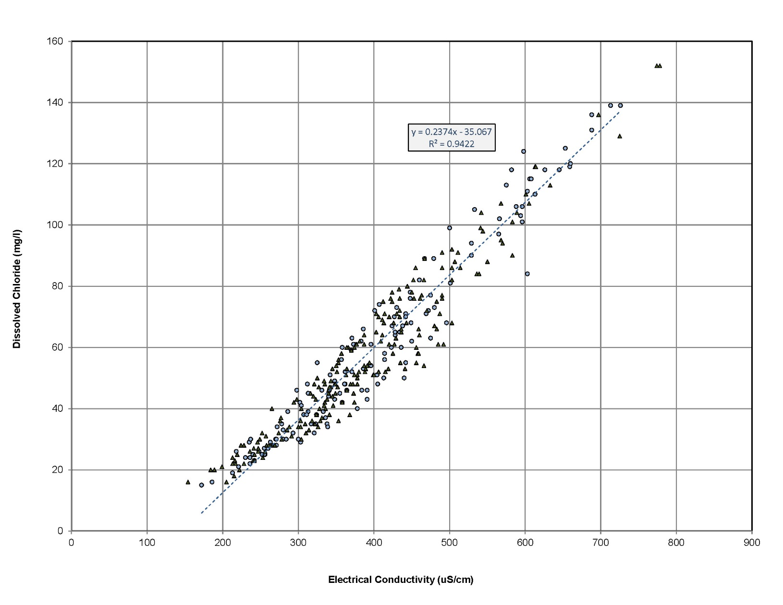
Middle River at Bordon Bridge Cl vs EC

Slide 6
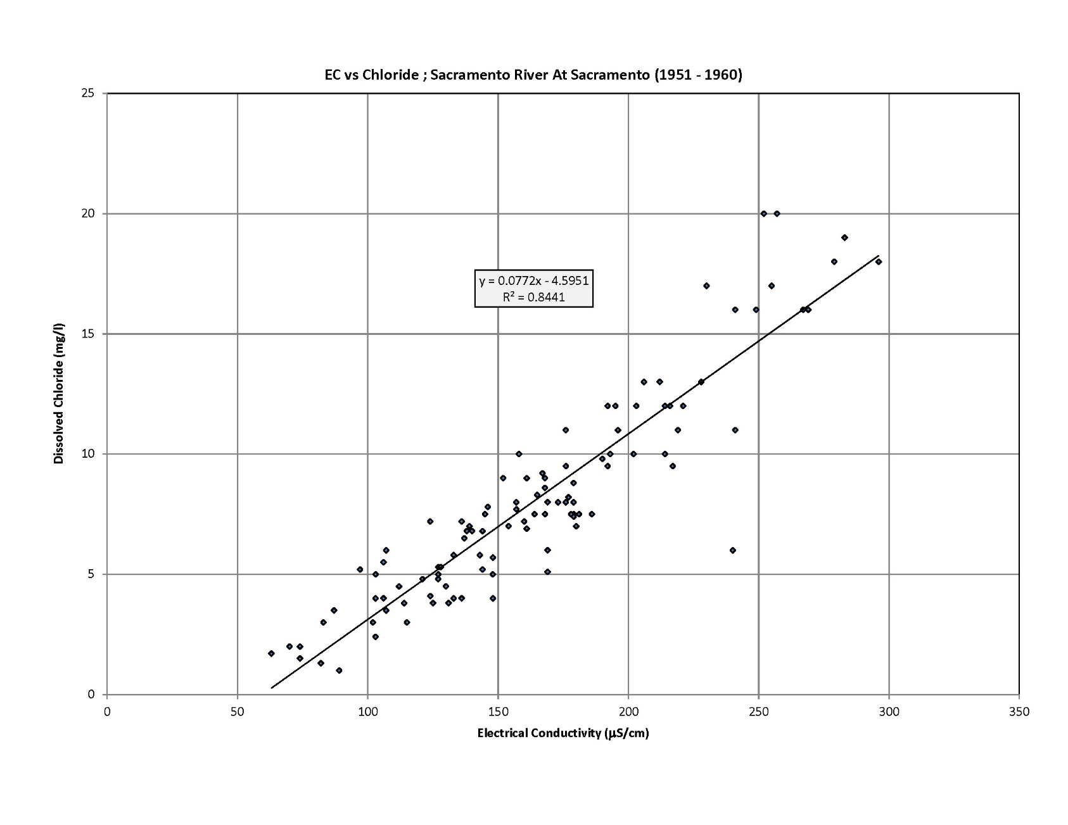
Sacramento River at Sacramento

Slide 7
Mean Monthly Salt Flux and Flow Rate At The South Delta Inflow/Outflow Points For The CWF NAA
 | NAA – Mean Monthly Average From 1923 to 2003
Month | SJR Vernalis |  | SJR At Burns Cut |  | Middle River |  | Old River |  | Exports |  | CCWD Diversion |  | Total
 | Chloride | Mean Flow | Chloride | Mean Flow | Chloride | Mean Flow | Chloride | Mean Flow | Chloride | Mean Flow | Chloride | Mean Flow | Chloride
 | (mt) | (cfs) | (mt) | (cfs) | (mt) | (cfs) | (mt) | (cfs) | (mt) | (cfs) | (mt) | (cfs) | (mt)
January | 23,319 | 5,060 | 8,728 | 1,904 | -11,351 | -1,300 | -22,386 | -2,446 | 60,683 | 6,921 | 374 | 40 | -12,728
February | 25,440 | 6,753 | 9,952 | 2,680 | -7,251 | -991 | -11,368 | -1,923 | 43,066 | 6,978 | 6 | 2 | -8,965
March | 25,330 | 6,773 | 9,880 | 2,765 | -6,224 | -927 | -8,559 | -1,784 | 35,690 | 6,603 | 6 | 1 | -5,462
April | 15,196 | 6,146 | 6,759 | 2,644 | -325 | 229 | 262 | 570 | 8,901 | 2,180 | 193 | 75 | -593
May | 14,979 | 5,971 | 6,139 | 2,475 | -792 | 88 | -487 | 336 | 8,240 | 2,273 | 384 | 118 | 1,495
June | 14,537 | 3,945 | 5,875 | 1,631 | -4,662 | -1,224 | -6,464 | -2,078 | 14,794 | 4,459 | 40 | 7 | 4,954
July | 12,803 | 2,590 | 3,745 | 854 | -9,531 | -3,066 | -20,463 | -5,438 | 34,508 | 9,024 | 417 | 122 | 4,126
August | 8,768 | 1,828 | 2,803 | 594 | -10,013 | -2,971 | -26,105 | -5,275 | 41,881 | 8,466 | 767 | 207 | -564
September | 10,205 | 2,199 | 4,971 | 1,062 | -13,466 | -2,885 | -39,156 | -5,180 | 65,487 | 8,572 | 972 | 203 | -8,604
October | 12,152 | 2,601 | 7,835 | 1,651 | -10,584 | -1,991 | -26,911 | -3,513 | 47,683 | 6,093 | 562 | 82 | -6,432
November | 12,094 | 2,423 | 7,568 | 1,481 | -12,455 | -2,252 | -32,660 | -4,056 | 56,963 | 7,027 | 532 | 72 | -7,854
December | 19,819 | 3,294 | 5,485 | 1,047 | -13,684 | -2,292 | -31,563 | -4,162 | 67,153 | 8,513 | 493 | 55 | -8,065
Mean Annual | 16,220 |  | 6,645 |  | -8,362 |  | -18,822 |  | 40,421 |  | 396 |  | -48,693
Notes:
1. The Downstream Direction Is Oriented Towards San Francisco Bay.
2. A Negative Flow Reflects Net Flow In The Upstream Direction.
3. A Negative Chloride Mass Flux Reflects A Net Salt Flux In The Upstream Direction.

Slide 8
Mean Monthly Salt Flux and Flow Rate At The South Delta Inflow/Outflow Points For The CWF PA
 | PA - Mean Monthly Average From 1923 to 2003
Month | SJR Vernalis |  | SJR At Burns Cut |  | Middle River |  | Old River |  | Exports |  | CCWD Diversion |  | Total
 | Chloride | Mean Flow | Chloride | Mean Flow | Chloride | Mean Flow | Chloride | Mean Flow | Chloride | Mean Flow | Chloride | Mean Flow | Chloride
 | (mt) | (cfs) | (mt) | (cfs) | (mt) | (cfs) | (mt) | (cfs) | (mt) | (cfs) | (mt) | (cfs) | (mt)
January | 23,319 | 5,060 | 14,776 | 2,727 | -6,878 | -514 | -13,371 | -964 | 36,697 | 3,811 | 337 | 35 | -8,242
February | 25,440 | 6,753 | 15,415 | 3,542 | -4,201 | -94 | -6,134 | -247 | 26,675 | 3,548 | 6 | 2 | -6,322
March | 25,331 | 6,772 | 15,286 | 3,651 | -2,543 | 224 | -2,359 | 373 | 17,406 | 2,393 | 8 | 1 | -2,468
April | 15,199 | 6,146 | 10,014 | 3,579 | -1,057 | 347 | -361 | 815 | 6,446 | 924 | 199 | 73 | -41
May | 14,981 | 5,971 | 9,361 | 3,338 | -1,089 | 275 | -739 | 698 | 4,819 | 898 | 302 | 96 | 2,327
June | 14,538 | 3,945 | 7,382 | 1,954 | -3,156 | -600 | -4,097 | -896 | 9,747 | 2,307 | 20 | 3 | 4,642
July | 12,803 | 2,590 | 4,505 | 972 | -5,330 | -1,410 | -8,338 | -2,315 | 17,273 | 4,086 | 451 | 122 | 4,240
August | 8,771 | 1,828 | 3,279 | 685 | -5,790 | -1,641 | -11,724 | -2,750 | 21,140 | 4,531 | 724 | 207 | 1,141
September | 10,206 | 2,199 | 4,516 | 969 | -4,955 | -1,103 | -11,288 | -1,799 | 22,849 | 3,485 | 883 | 203 | -1,798
October | 12,152 | 2,601 | 9,300 | 1,973 | -3,980 | -643 | -8,276 | -970 | 16,026 | 1,899 | 570 | 83 | -1,488
November | 12,094 | 2,423 | 6,881 | 1,367 | -5,441 | -907 | -11,731 | -1,537 | 25,182 | 3,284 | 447 | 72 | -3,243
December | 19,819 | 3,294 | 5,670 | 1,071 | -11,047 | -1,942 | -23,246 | -3,511 | 55,143 | 7,510 | 417 | 55 | -7,117
Mean Annual | 194,652 |  | 106,385 |  | -55,467 |  | -101,663 |  | 259,402 |  | 4,364 |  | -18,370
Notes:
1. The Downstream Direction Is Oriented Towards San Francisco Bay.
2. A Negative Flow Reflects Net Flow In The Upstream Direction.
3. A Negative Chloride Mass Flux Reflects A Net Salt Flux In The Upstream Direction.

Slide 9
Summary of Mean Monthly Salt Loading for The PA and the NAA
 | Total | Total |  | PA-NAA Diff
Month | Chloride | Chloride |  | Chloride
 | (mt) | (mt) |  | (mt)
January | -12,728 | -8,242 |  | 4,487
February | -8,965 | -6,322 |  | 2,643
March | -5,462 | -2,468 |  | 2,994
April | -593 | -41 |  | 552
May | 1,495 | 2,327 |  | 832
June | 4,954 | 4,642 |  | -312
July | 4,126 | 4,240 |  | 114
August | -564 | 1,141 |  | 1,706
September | -8,604 | -1,798 |  | 6,806
October | -6,432 | -1,488 |  | 4,943
November | -7,854 | -3,243 |  | 4,611
December | -8,065 | -7,117 |  | 948
 |  | Mean Annual = |  | 30,323

Slide 10
Comparison of Salt Loading Between The CWF PA and the NAA

Slide 11
Conclusion
Based on my analysis of the hydrodynamic and water quality data contained within the Petitioners hydrodynamic model, DSM2, it is my opinion that there will be a significant increase in salt loading to the South Delta.
On average, there will be an increase of roughly 30,000 metric tons of salt brought into the South Delta each year under the CWF PA. The details supporting my opinion are provided below.

